Slide 1
NDCF Orientation Review of Computational Approaches
8 August 2025
Vilas Menon

Slide 2
Outline
Main types of computational approaches
Data analysis approaches
Supervised approaches & Basic statistics
Unsupervised approaches
Summary

Slide 3
Computational Neuroscience/Neurobiology
Goals of computational research
To understand biological phenomena, extract signals from large data sets, make predictions, and generate hypotheses
Models
Simulations
Analysis
Predictors
 | Explanatory | Predictive | Data requirements
Models | Yes | Yes | Any
Simulations | Sometimes | Yes | Any
Analysis | Yes | No | Small scale or large scale
Predictor | No | Yes | Usually large-scale
All of these approaches usually require experimental validation!

Slide 4
What is machine learning?
“The field of study that gives computers the ability to learn without being explicitly programmed." (Arthur Samuel)
"A computer program is said to learn from experience E with respect to some class of tasks T and performance measure P, if its performance at tasks in T, as measured by P, improves with experience E." (Tom Mitchell)

Slide 5
Traditional Programming
Machine Learning
Data
Computer
Output
Program
Data
Computer
Model/Program
Output

Slide 6

Terminology
Artificial Intelligence (AI)
Machine Learning (ML)
Deep Learning (DL)

Slide 7

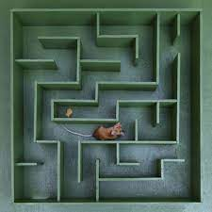
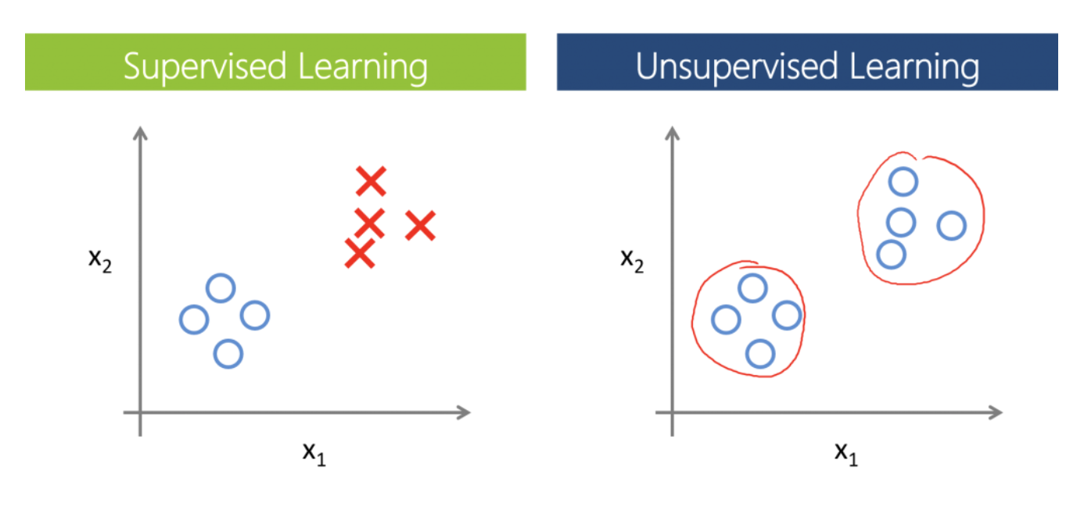

Types of machine learning approaches/problems
Labeled Data
Unlabeled Data
Evaluation of scenarios
D C D C D
Supervised learning
Unsupervised learning
Reinforcement learning
Semi-supervised learning
Differential analysis
Classification & mapping
Object recognition
Standard statistical tests
Clustering
Pattern/feature recognition
Identifying underlying structure
Game playing
Maze solving
Navigation

Slide 8

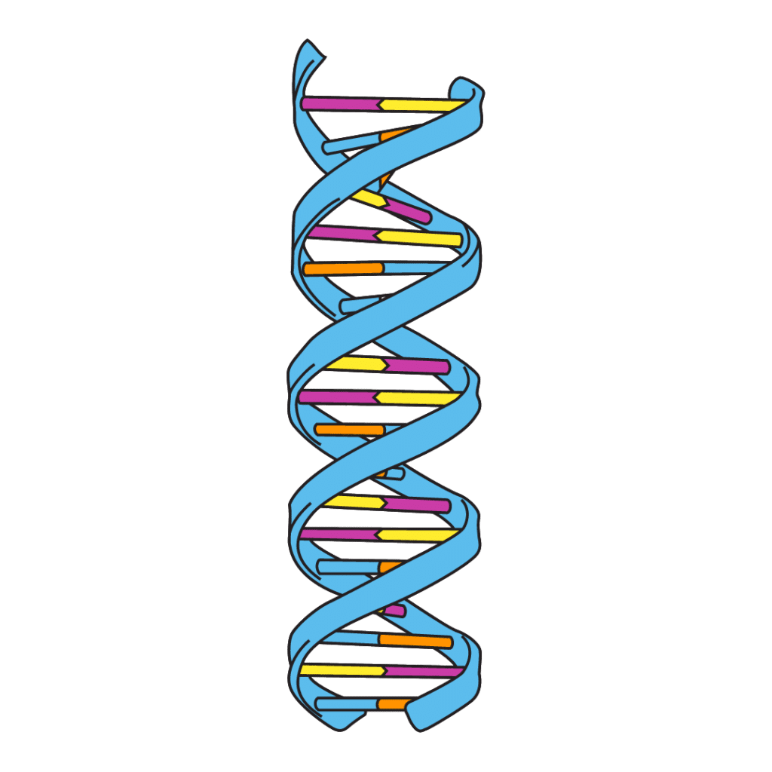
Data analysis – what do data sets look like?
Labeled
Unlabeled
Observed objects
D C D C D
Features
Ordered
Unordered
Time series
Genes

Slide 9
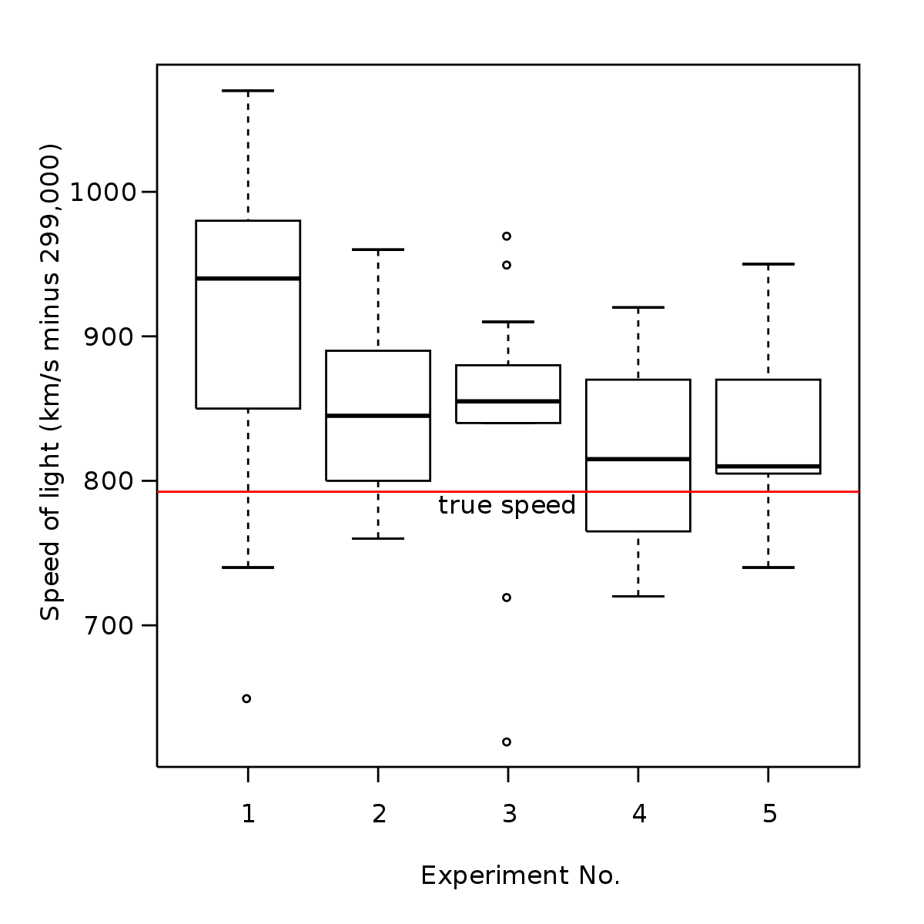
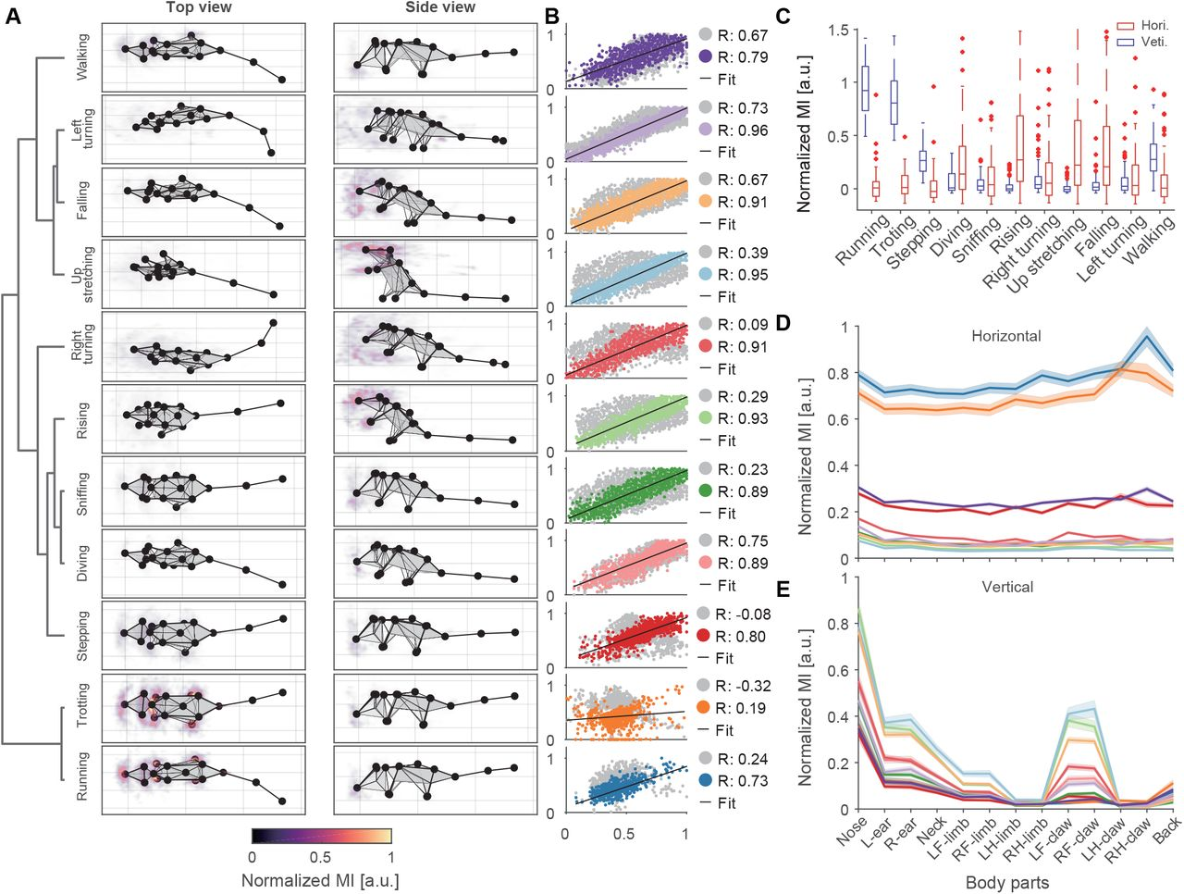
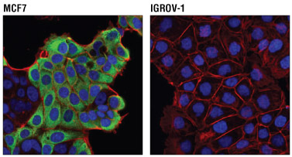
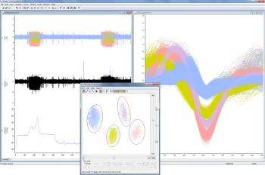
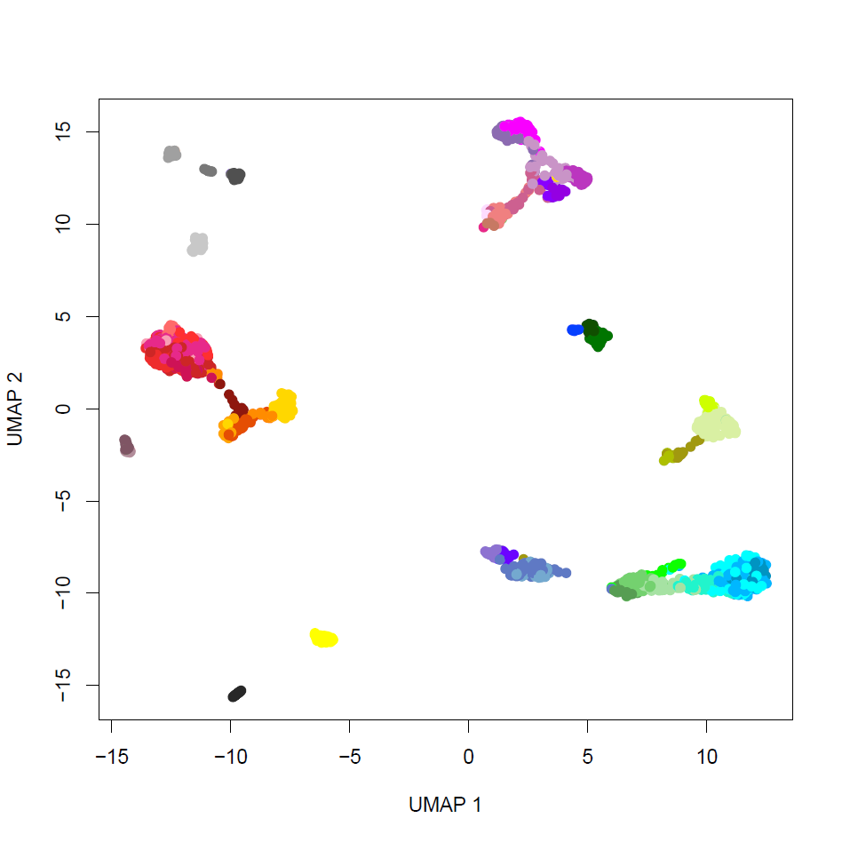
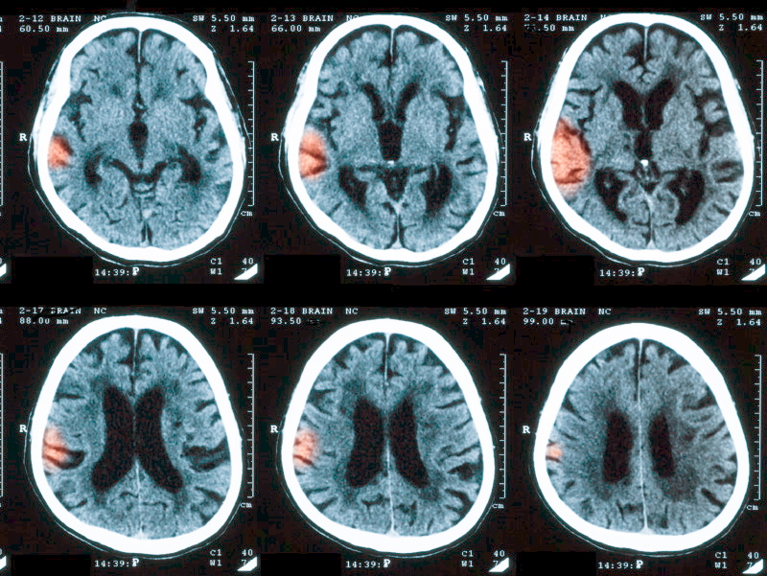
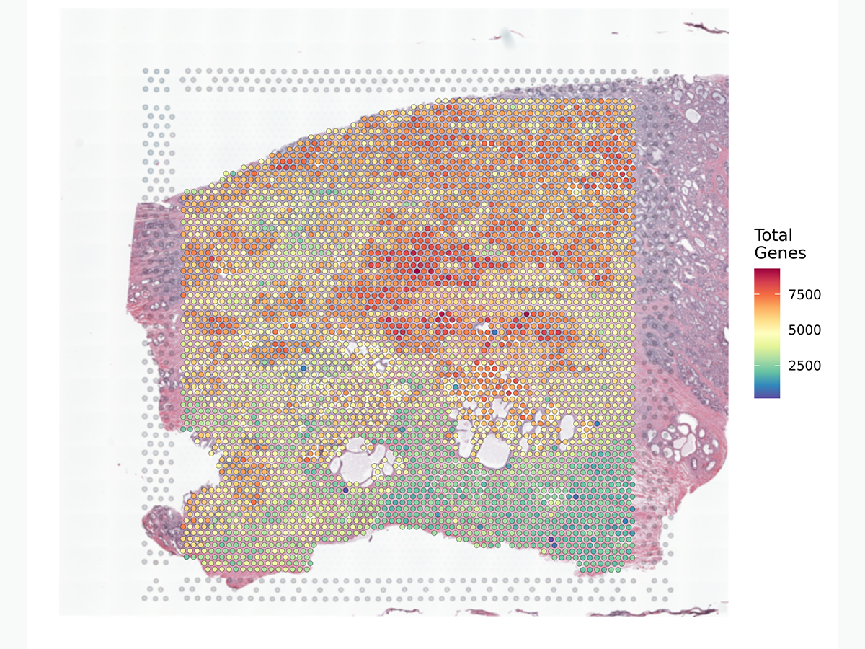
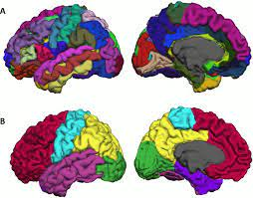
Supervised and unsupervised analysis in biology
Supervised
Unsupervised
Standard statistical analysis
Behavioral analysis
Image segmentation
Spike sorting
Diagnostics
Transcriptomics
Spatial analysis
Brain parcellation

Slide 10
Supervised analysis - Differential feature identification
Which features distinguish Groups from each other?
Group 1
Observed objects
Group 2
“Standard” statistical methods seek to answer this question:
Does the mean value of a feature differ between groups? (e.g. t-test, ANOVA)
Is the distribution of a feature different between two groups? (e.g. K-S test)
Is the value of a feature enriched in one group versus another? (e.g. Chi-squared test, Fisher’s exact test)
Are the “groups” continuous? (Regression)
Group 3
Features

Slide 11
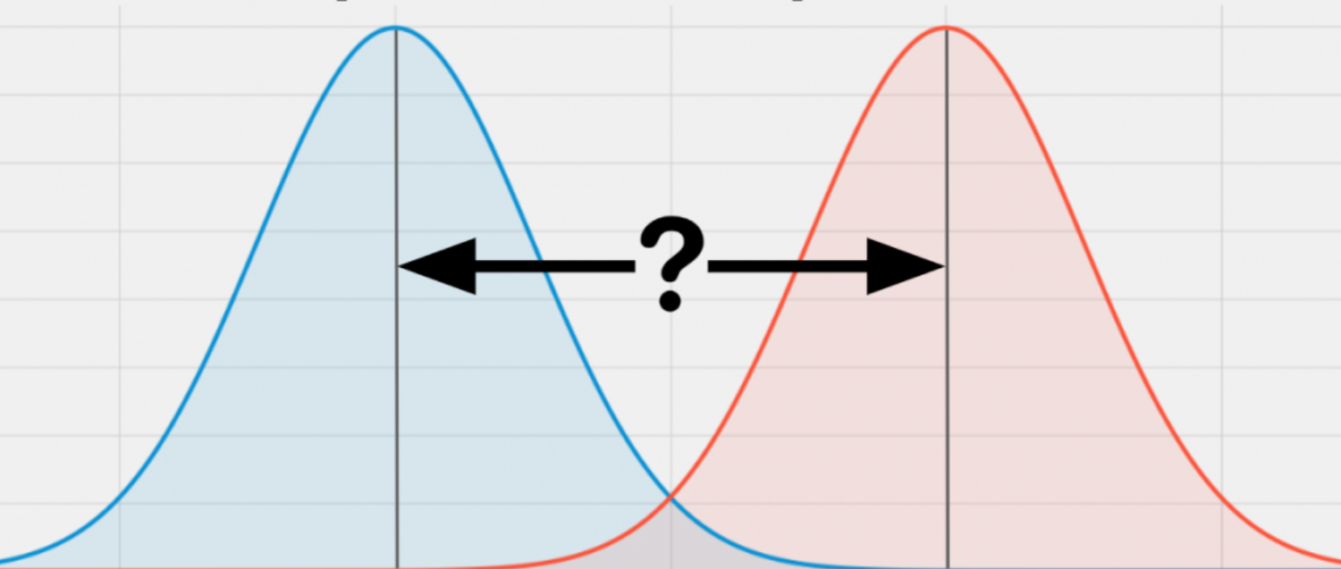
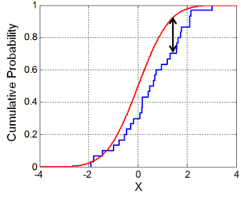
What differences are we looking for?
Does the mean value of a feature differ between groups? (e.g. t-test, ANOVA)
Is the distribution of a feature different between two groups? (e.g. K-S test)

Slide 12
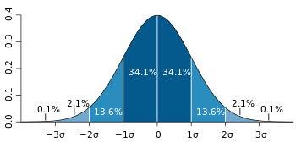
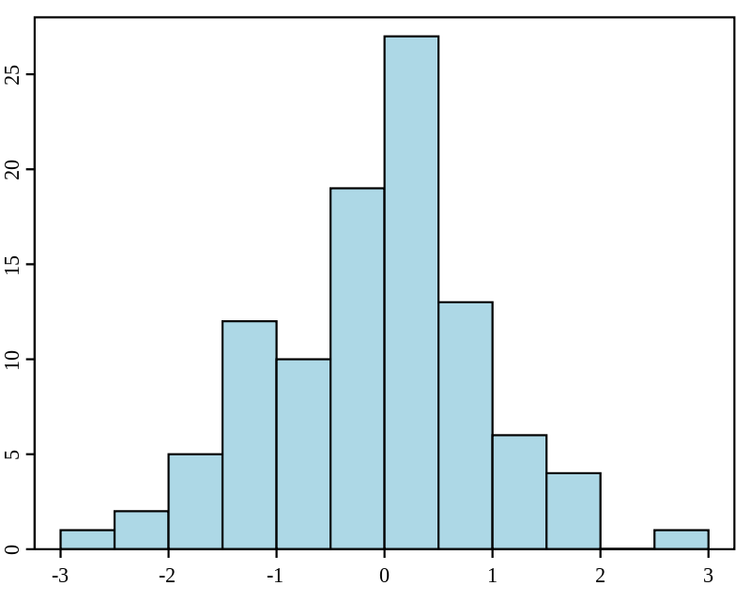
Parametric and nonparametric tests
Parametric test assumes an underlying statistical distribution of the feature
Nonparametric test makes no assumption about the underlying distribution
Parametric test | Nonparametric test
Usually has greater power (sensitivity) | Less likely to return false positives
Generally uses mean as central measure | Generally uses median as central measure
Unpaired t-test (2 groups) | Mann-Whitney test
Paired t-test (2 groups, paired) | Wilcoxon rank sum test
ANOVA (>2 groups) | Kruskal-Wallis test

Slide 13
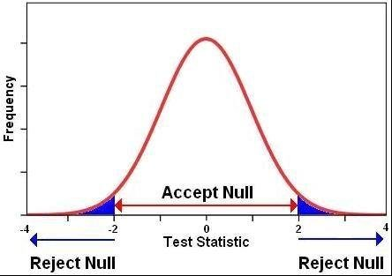
P-values
Statistical tests looking for differences in feature distributions usually return a “p-value”
What is a p-value?
The probability of getting a result at least as extreme as the one observed, given the null hypothesis is true
If we observe a result that is highly unlikely to be observed from the null, we reject the null distribution and say that the finding is statistically significant (p<0.05, p<0.01, etc.)

Slide 14
Multiple testing burden
Recall: p-value tells us how unlikely a specific finding is if the null distribution is true
If we run 1000 tests, and the null is true, we would expect 50 tests to still have a p-value <=0.05
These are false positives (type 1 errors)
We need to “adjust” the p-values when running multiple tests
Multiple methods exist for p-value adjustment
Bonferroni correction: p_{adjusted} = min(1, p_{raw}*N_{tests})
Very conservative (low chance of false positives, but also low power)
False Discovery Rate: set the ratio of false positives to true positives
Less conservative (higher power, but higher chance of false positives)

Slide 15
Recap - Differential feature identification
Group 1
Observed objects
Decision points:
Statistical test – What are we asking? How many groups are there? Are they paired or unpaired?
Parametric vs. nonparametric test – Do we know anything about the underlying distribution?
Multiple testing correction – Do we need to adjust the p-values?
Group 2
Group 3
Features

Slide 16
Pause for questions

Slide 17
Types of machine learning approaches/problems
Labeled Data
Unlabeled Data
Evaluation of scenarios
D C D C D
Supervised learning
Unsupervised learning
Reinforcement learning
Semi-supervised learning
Differential analysis
Classification & mapping
Object recognition
Standard statistical tests
Clustering
Pattern/feature recognition
Identifying underlying structure
Game playing
Maze solving
Navigation

Slide 18

Supervised analysis: classification
Goal: given a labeled set of training data, classify new objects
D C D C D
Training
Classifier
Classifier
Cat

Slide 19
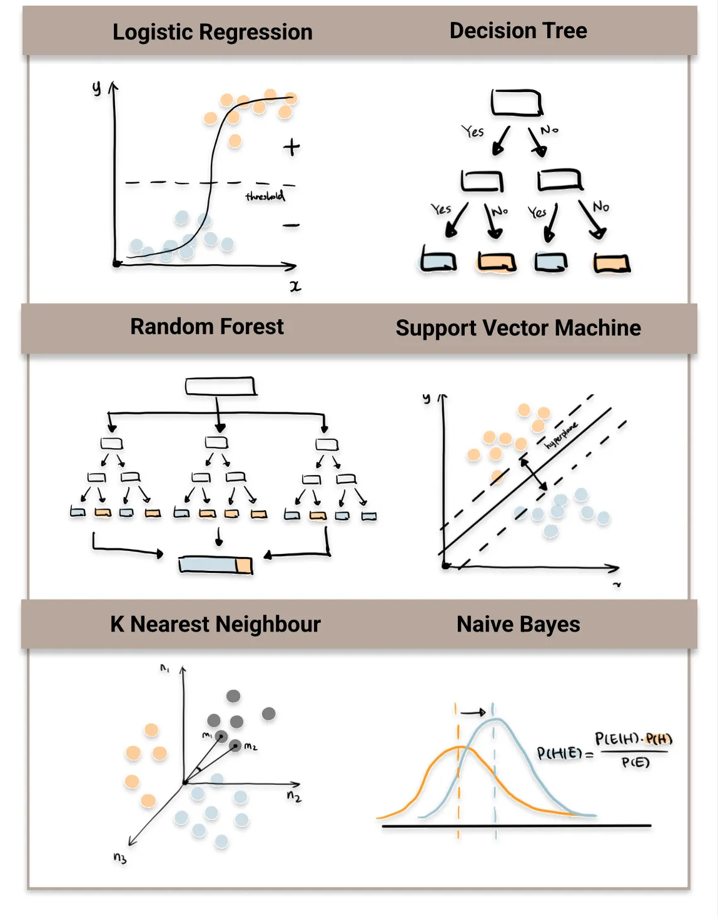
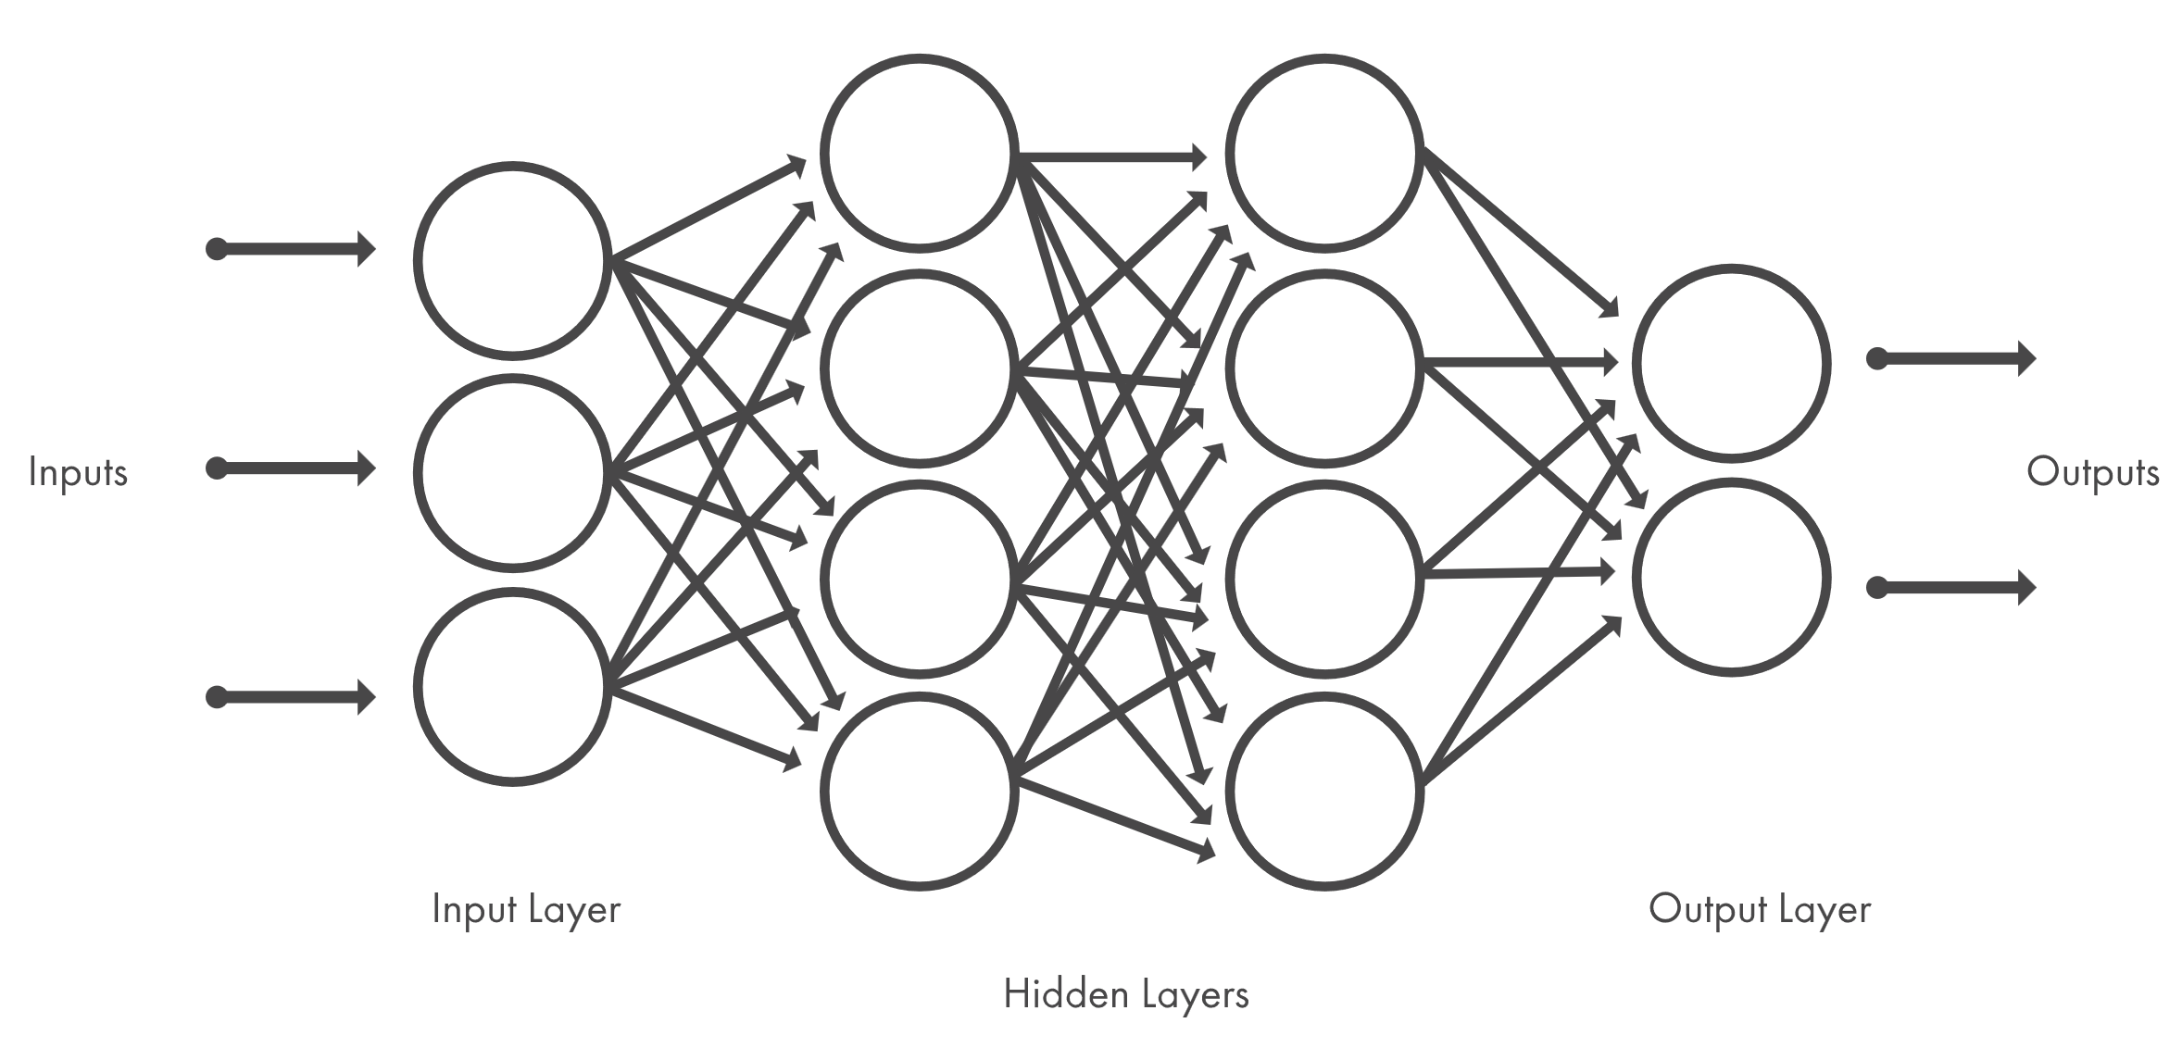
Types of classification algorithms
Neural networks/deep learning
Mathworks (2021)
Destin Gong (2022)

Slide 20

Training and testing classification algorithms
The #1 danger in classification algorithms is overfitting:
Classifier does not generalize beyond the training set
How can we avoid overfitting?
1) Reduce the number of parameters
2) Use a training and holdout (test) set:
If classifier performs poorly on test set, it is likely overfitted

Slide 21
Training, test, and holdout sets
Holdout set: used to evaluate model with final parameter set
Training set: used to fit the model
Test set: used to evaluate model with a specific set of parameters
If models with different parameters are evaluated (using test sets) to find the optimal parameter set

Slide 22
Evaluating models – Confusion matrix
To be applied on the test or holdout set for evaluation
Can be used on training set to assess where the algorithm is struggling
 | Entities predicted to be in class A | Entities predicted to be in class B
Entities actually belonging to class A | Correct | Incorrect
Entities actually belonging to class B | Incorrect | Correct
Often, the confusion matrix is summarized as total % correct
But always check the full matrix – why?
% correct can be skewed by largest classes

Slide 23
Supervised analysis: review
Observed objects are labeled
Uses:
Differential feature identification
Classification
Object recognition
Key points:
Train/test/holdout sets
Confusion matrix for evaluation
Labeled
Observed objects
D C D C D
Features

Slide 24
Supervised analysis/classification – R code

Slide 25
Unsupervised Analysis
No pre-defined grouping among the observed objects
No categories
No labels
Goals:
Uncover underlying structure (let the data “self-organize”)
Discover groupings/relationships among the observed objects
Identify the major modes of variation among the features

Slide 26
Types of machine learning approaches/problems
Labeled Data
Unlabeled Data
Evaluation of scenarios
D C D C D
Supervised learning
Unsupervised learning
Reinforcement learning
Semi-supervised learning
Differential analysis
Classification & mapping
Object recognition
Standard statistical tests
Clustering
Pattern/feature recognition
Identifying underlying structure
Game playing
Maze solving
Navigation

Slide 27
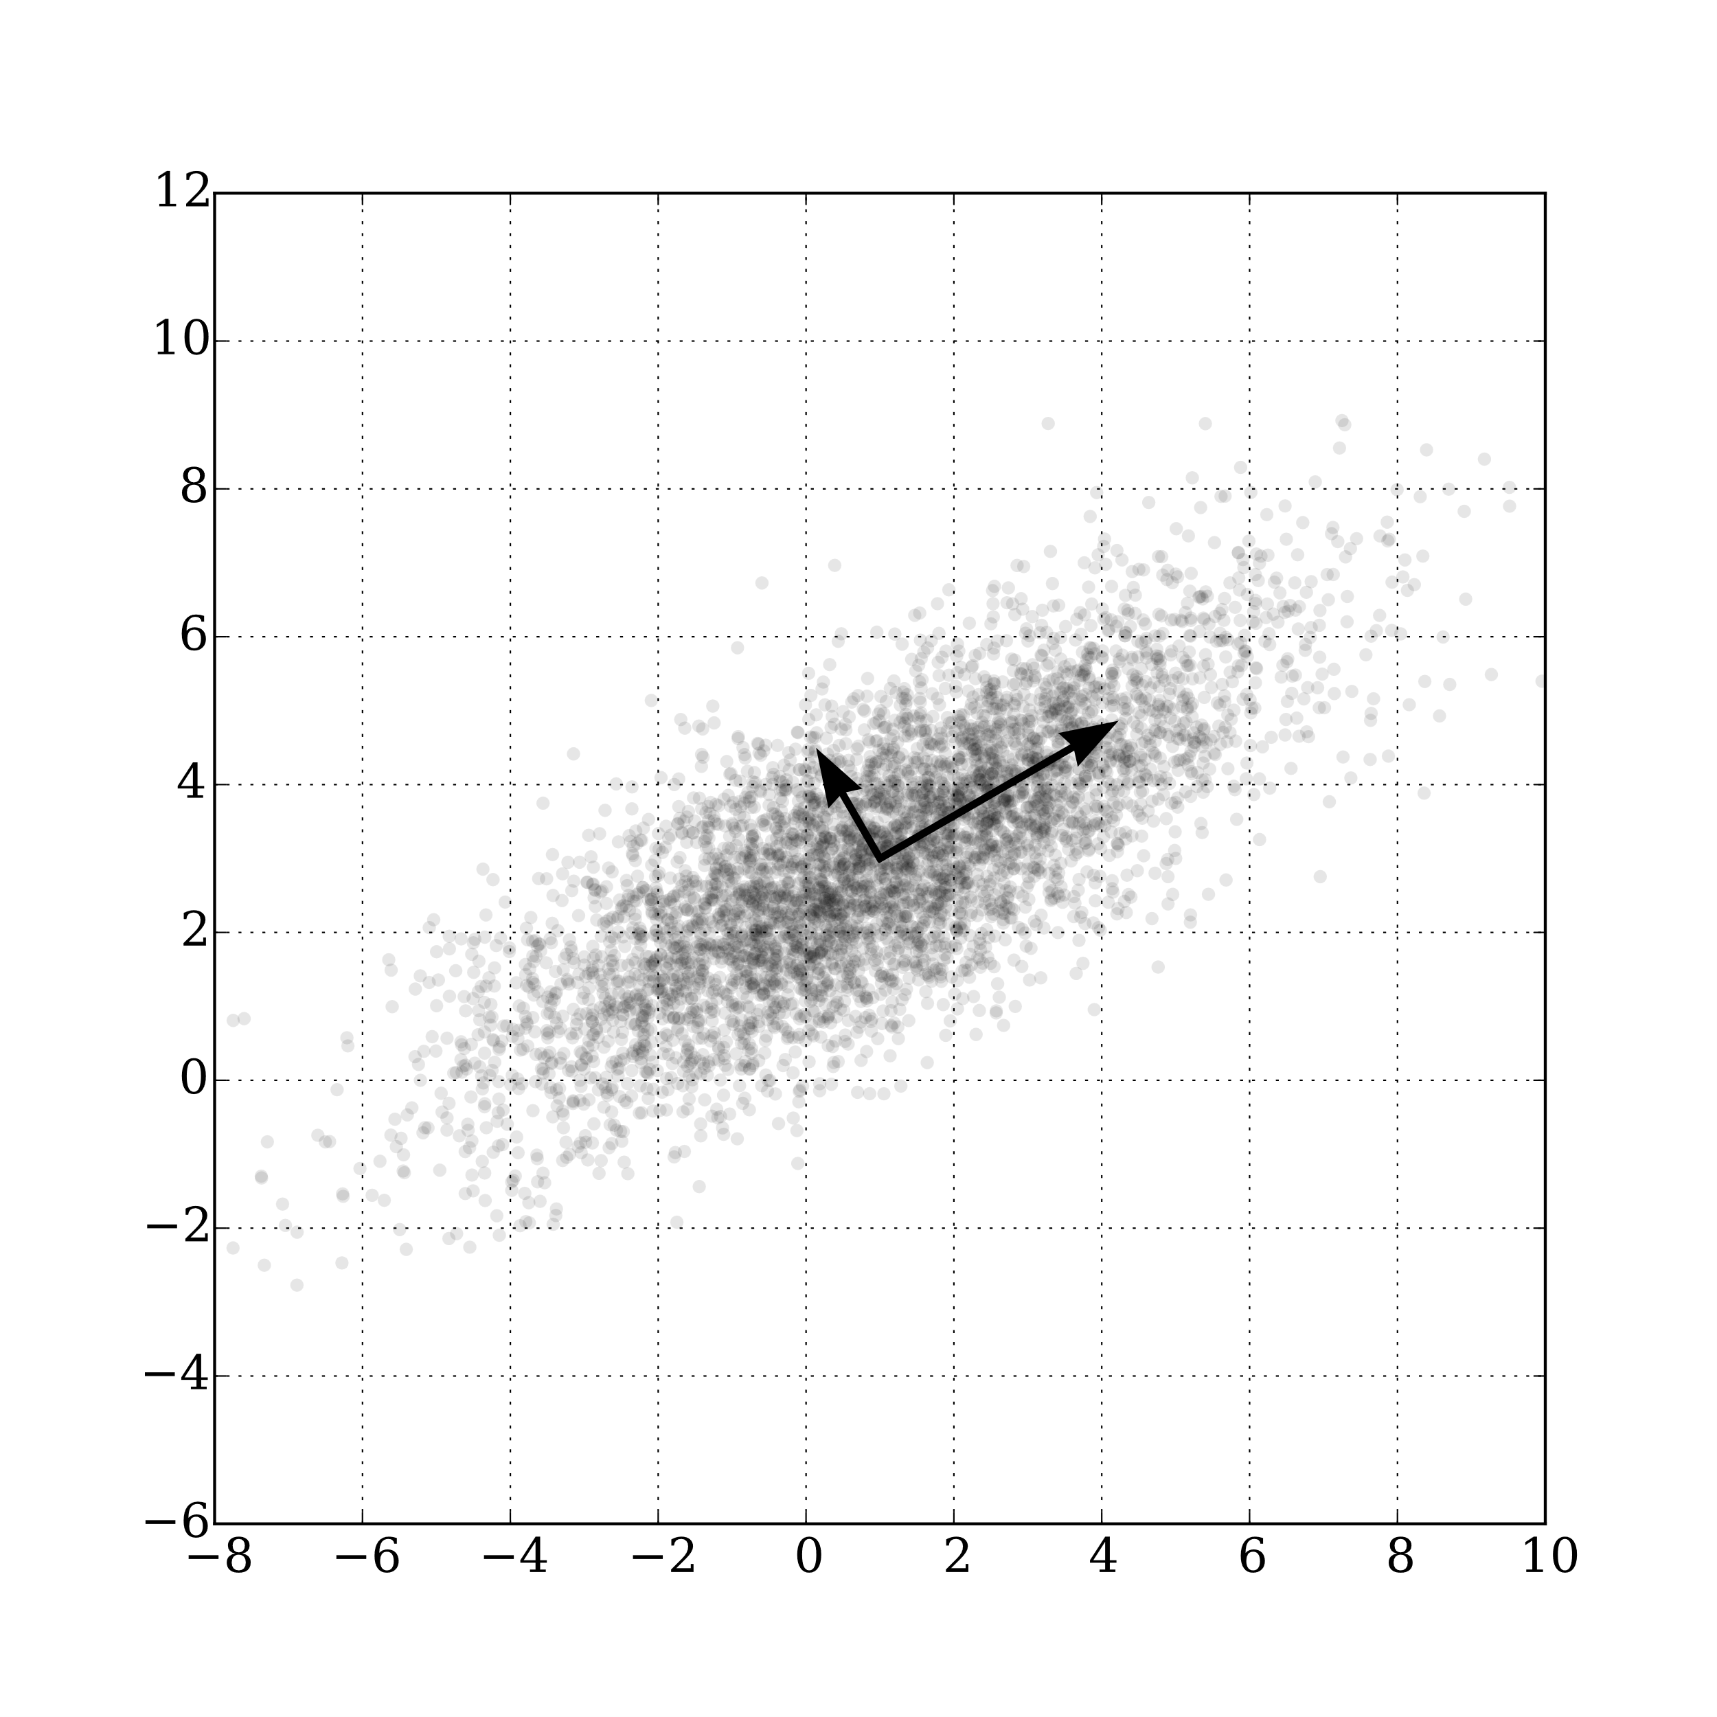
Unsupervised analysis: dimensionality reduction
Features
Mode1
Mode2
“Group” 1
Observed objects
“Group” 2
“Group” 3
One widely used method is Principal Component Analysis (PCA)

Slide 28
Principal Component Analysis
Goal: Identify weighted groups of features that explain the variance in the data
The first principal component (PC) accounts for the largest proportion of variation in the data
Subsequent PCs account for the remaining variance
PCs are (by definition) orthogonal
PCA is deterministic (no randomness)

Slide 29
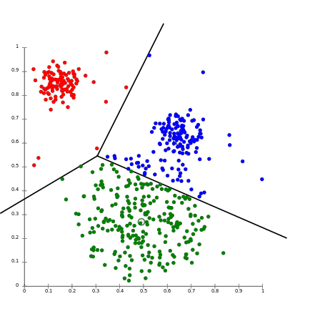
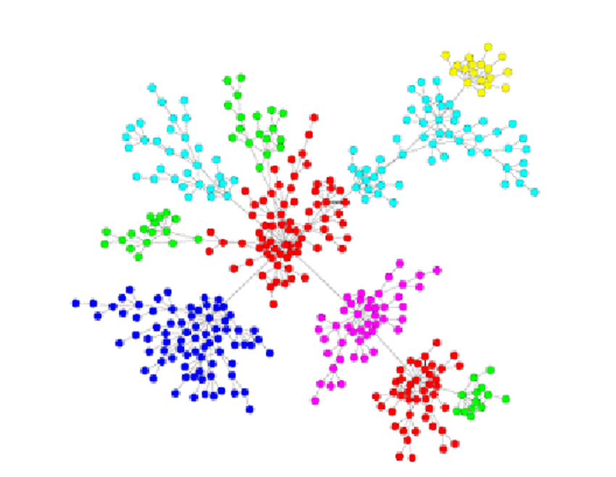
Why perform dimensionality reduction?
Cluster into groups
Characterize relationships
Increase signal-to-noise

Slide 30
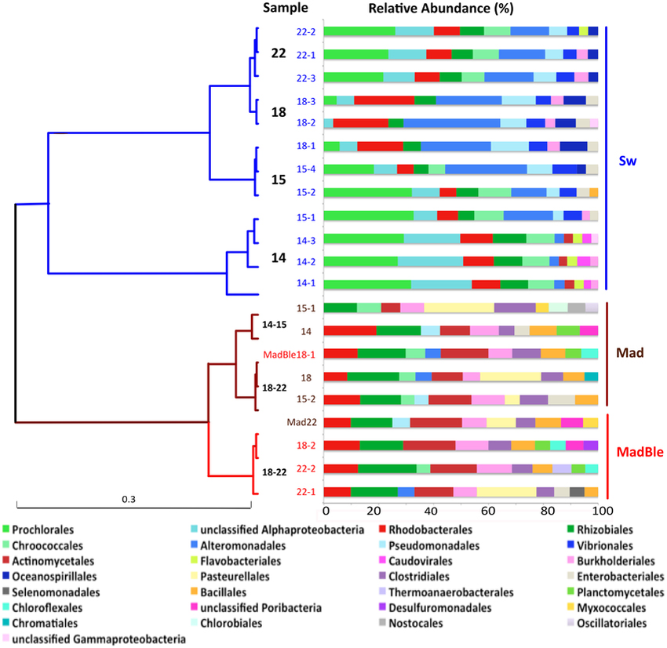
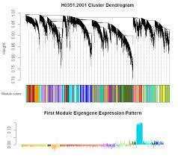
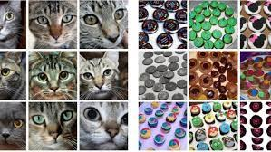
Unsupervised analysis: clustering
Goal: Identify further structure in the data when observations (or features) are not labeled
Metagenomics
Behavioral analysis
Spike sorting
Bulk RNA-seq & proteomics
Single-cell analysis
Image clustering
Functional/structural imaging

Slide 31
PCA Example: Code in R

Slide 32
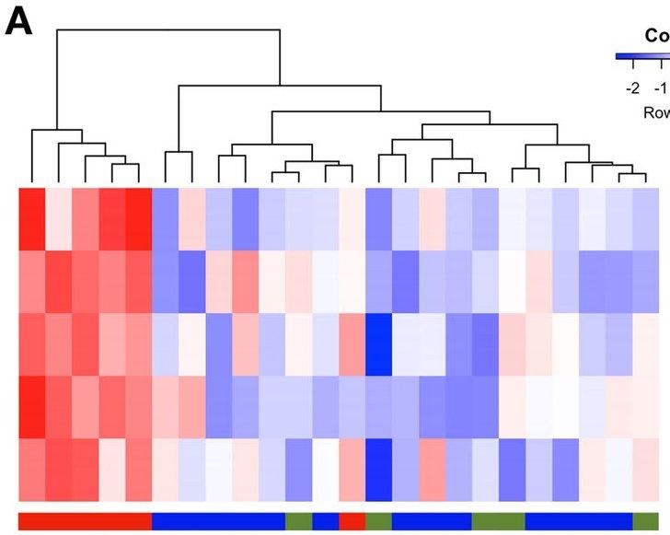
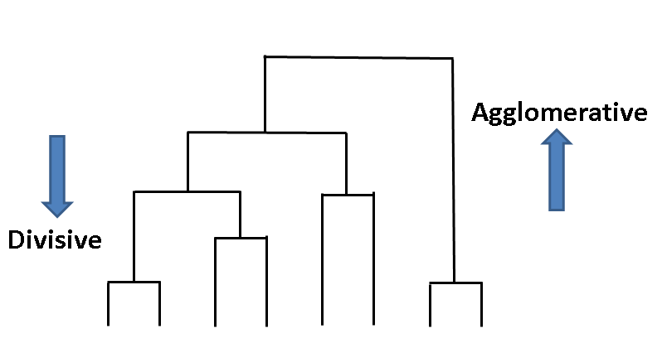
Unsupervised analysis: clustering
Clustering requires:
A distance metric
An algorithm to assign elements to groups
2 major classes: 1) Agglomerative clustering (“building up” of clusters from elements)
2) Divisive clustering (“splitting” data into clusters)

Slide 33
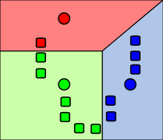
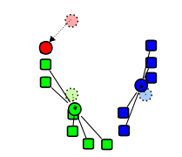
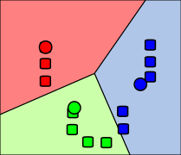
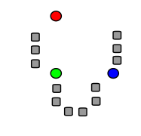
K-means clustering
Select n (pre-specified parameter) random centroids
Associate every data point to its closest mean using the distance metric
Recalculate centroids
Repeat until no changes are made
Initial selection of centroids is random
Number of clusters is pre-specified
Wikipedia.org

Slide 34
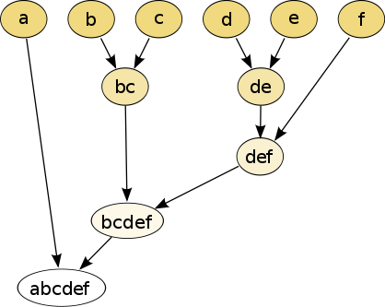
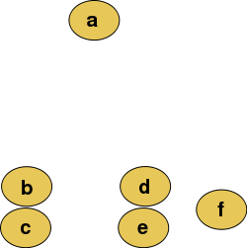
Hierarchical clustering
Using a distance metric, successively group pairs of elements into a tree
After each grouping, recalculate distance metric for new group
Cut the final tree at a specific height to get individual clusters
Wikipedia.org

Slide 35
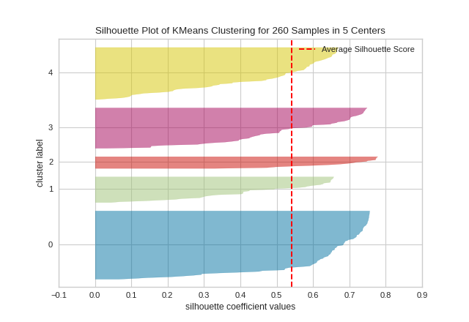
How many clusters are there?
Select a given number of clusters and assess separation
Within-cluster distance versus between-cluster distance
Silhouette plots (within-cluster distance compared to “closest” cluster for each point)
Post-hoc classification (supervised learning)
Visualize the data! (Heuristic)
Biological interpretation! (Do the clusters mean anything?)

Slide 36
Clustering example: R code

Slide 37
Pause for questions

Slide 38
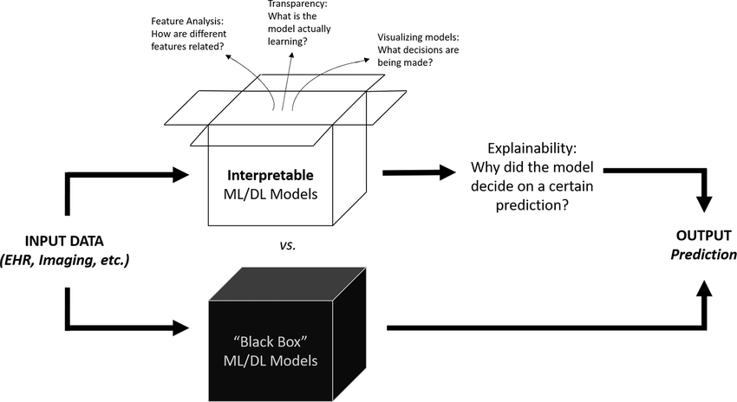
Predictors: “Black box” versus “Interpretable”
Hui et al. (2021)

Slide 39
Computational Neuroscience/Neurobiology
Goals of computational research
To understand biological phenomena, extract signals from large data sets, make predictions, and generate hypotheses
Models
Simulations
Analysis
Predictors
 | Explanatory | Predictive | Data requirements
Models | Yes | Yes | Any
Simulations | Sometimes | Yes | Any
Analysis | Yes | No | Small scale or large scale
Predictor | No | Yes | Usually large-scale
All of these approaches usually require experimental validation!

